Slide 1
Software Defined Networks: Overview
K. K. Ramakrishnan
(with thanks to many people’s material that I have re-used: David Koll, Univ. of Goettingen, Germany, Jennifer Rexford, Princeton, Nick Mckeown, Stanford and others).

Slide 2
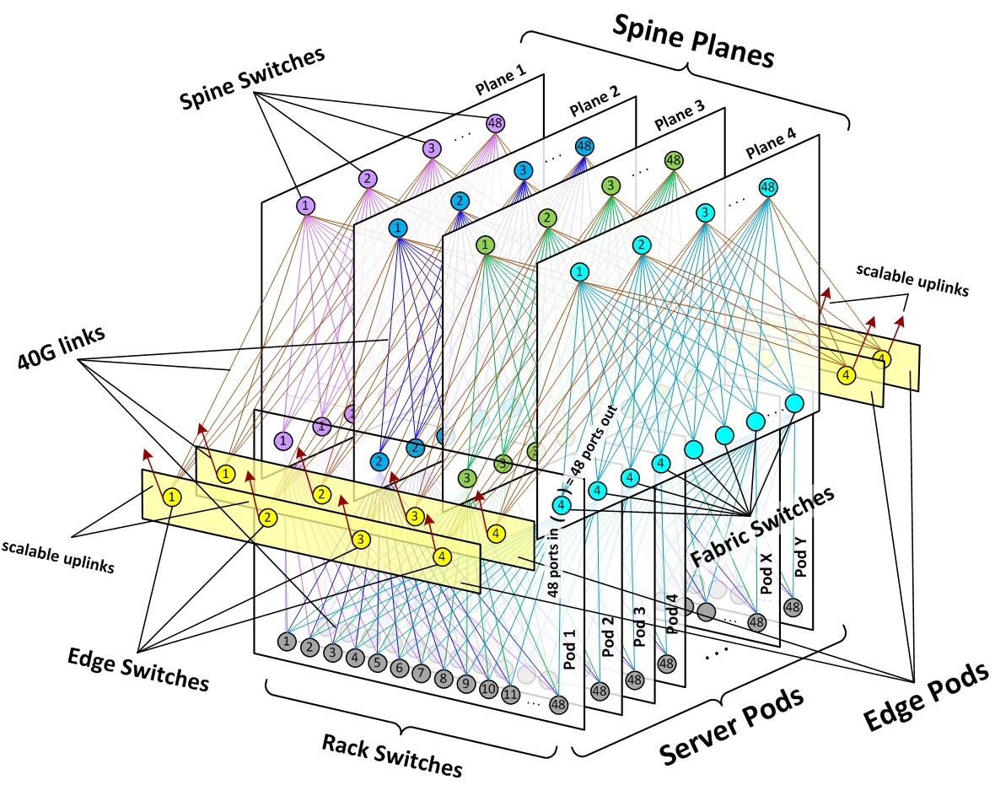
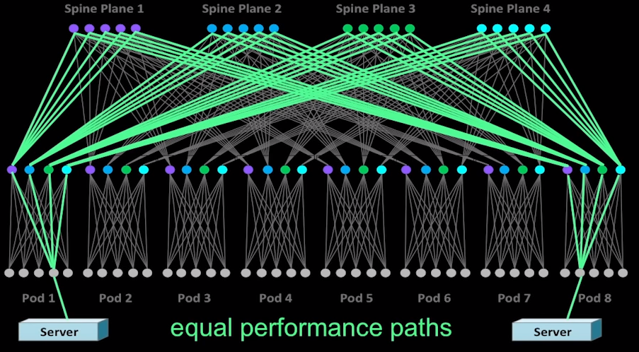
Data Centers can be large: Configuration and Management
Google: 98K servers, 5632 switches
Facebook: 184K servers, 5184 switches
Microsoft VL2: 46K servers, 2448 switches (limited switch ports)
Data Center Topology
Inside the social network’s (datacenter) network, SIGCOMM’15

Slide 3
Bottleneck: The Network
“The average cloud environment might have 50 dedicated servers to one admin, and what you really need to get to is 500 servers to one admin, or what happened in the case of Microsoft, 10,000 servers. Without automation we don't have speed and scale - the very reason we want to go to the cloud.” (Microsoft)
Complex with standard IP networking (mainly manual processes: have to manually configure each device with physical presence!)

Slide 4
Bottleneck: The Network
“Even simple topologies take days or weeks to create. Workload placement and mobility are restricted by physical network limitations and hardware dependencies require vendor-specific expertise. Network configuration is performed manually and maintenance is both expensive and resource-intensive.” (VMWare)
We need automation!

Slide 5
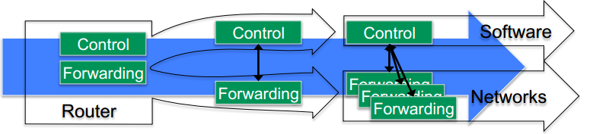
Software Defined Networking
Solution: Software-Defined-Networking (SDN)
Decouples the control plane from the data plane
Images taken from materials of the Open Networking Foundation: https://www.opennetworking.org/

Slide 6
The network is changing
Feature
Feature
Network OS
Feature
Feature
OS
Custom Hardware
Feature
Feature
OS
Feature
Feature
Custom Hardware
OS
Feature
Feature
Custom Hardware
OS
Custom Hardware
Feature
Feature
OS
Custom Hardware

Slide 7

Software Defined Network (SDN)
3. Consistent, up-to-date global network view
2. At least one Network OS probably many. Open- and closed-source
Feature
Feature
Network OS
1. Open interface to packet forwarding
Packet
Forwarding
Packet
Forwarding
Packet
Forwarding
Packet
Forwarding
Packet
Forwarding

Slide 8
Network OS
Network OS: distributed system that creates a consistent, up-to-date network view
Runs on servers (controllers) in the network
NOX, ONIX, Trema, Beacon, Maestro, ONOS,… + more
Uses forwarding abstraction to:
Get state information from forwarding elements
Give control directives to forwarding elements

Slide 9
Software Defined Network (SDN)
Control Program A
Control Program B
Network OS
Packet
Forwarding
Packet
Forwarding
Packet
Forwarding
Packet
Forwarding
Packet
Forwarding

Slide 10
Control Program
Control program operates on view of network
Input: global network view (graph/database)
Output: configuration of each network device
Control program is not a distributed system
Abstraction hides details of distributed state

Slide 11
Forwarding Abstraction
Purpose: Abstract away forwarding hardware
Flexible
Behavior specified by control plane
Built from basic set of forwarding primitives
Minimal
Streamlined for speed and low-power
Control program not vendor-specific
OpenFlow is an example of such an abstraction

Slide 12
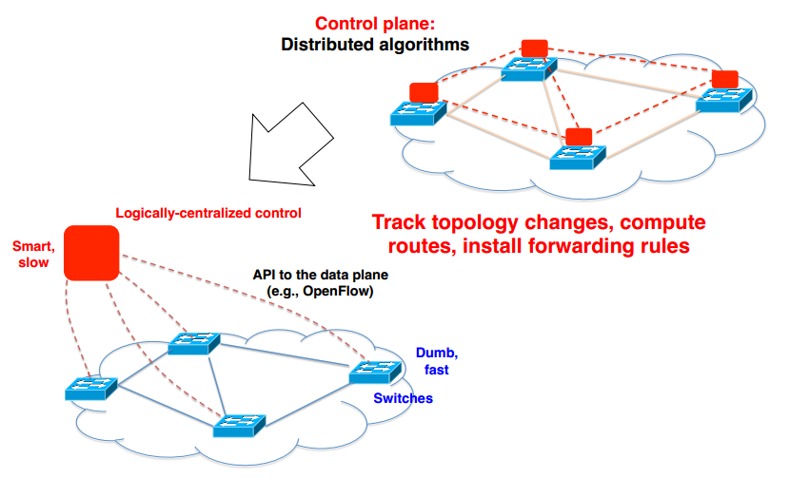
Software Defined Networking

Slide 13
Data and Control Planes
Processor
control plane
data plane
Switching
Fabric
Line card
Line card
Line card
Line card
Line card
Line card

Slide 14
Data Plane
Streaming algorithms on packets
Matching on some bits
Perform some actions
Wide range of functionality
Forwarding
Access control
Mapping header fields
Buffering and marking
Shaping and scheduling
Traffic monitoring
Deep packet inspection
Processor
Switching
Fabric

Slide 15
Switch: Match on Destination MAC
MAC addresses are location independent
Assigned by the vendor of the interface card
Cannot be aggregated across hosts in LAN
mac1
mac2
mac3
host
host
...
host
mac1
mac2
mac3
mac4
mac5
host
switch
mac4
host
mac5

Slide 16
Router: Match on IP Prefix
IP addresses grouped into common subnets
Allocated by ICANN, regional registries, ISPs, and within individual organizations
Variable-length prefix identified by a mask length
1.2.3.4
1.2.3.7
1.2.3.156
5.6.7.8
5.6.7.9
5.6.7.212
host
host
...
host
host
host
...
host
LAN 1
LAN 2
router
router
router
WAN
WAN
1.2.3.0/24
Prefixes may be nested. Routers identify the longest matching prefix.
5.6.7.0/24
forwarding table

Slide 17
Forwarding vs. Routing
Forwarding: data plane
Directing a data packet to an outgoing link
Individual router using a forwarding table
Routing: control plane
Computing paths the packets will follow
Routers talking amongst themselves
Individual router creating a forwarding table

Slide 18
Example: Shortest-Path Routing
Compute: path costs to all nodes
From a source u to all other nodes
Cost of the path through each link
Next hop along least-cost path to destination
link
v
(u,v)
v
2
y
w
(u,w)
3
1
1
x
(u,w)
x
4
z
u
y
(u,v)
2
1
w
5
t
z
(u,v)
4
3
s
(u,w)
6
s
t
(u,w)

Slide 19
Distributed Control Plane
Link-state routing: OSPF, IS-IS
Flood the entire topology to all nodes
Each node computes shortest paths
Dijkstra’s algorithm
link
v
(u,v)
2
w
(u,w)
v
y
3
1
x
(u,w)
1
x
4
u
z
y
(u,v)
2
1
5
z
(u,v)
t
w
4
3
s
(u,w)
s
t
(u,w)
19

Slide 20
Distributed Control Plane
Distance-vector routing: RIP, EIGRP
Each node computes path cost
… based on each neighbors’ path cost
Bellman-Ford algorithm (dynamic programming)
d_{u}(z) = min{c(u,v) + d_{v}(z),
c(u,w) + d_{w}(z)}
v
2
y
3
1
1
x
4
u
z
2
1
5
t
w
4
3
s

Slide 21
Traffic Engineering Problem
Management plane: setting the weights
Inversely proportional to link capacity?
Proportional to propagation delay?
Network-wide optimization based on traffic?
2
3
1
1
3
2
3
1
5
4
3

Slide 22
Traffic Engineering: Optimization
Inputs
Network topology
Link capacities
Traffic matrix
Output
Link weights
Objective
Minimize max-utilized link
Or, minimize a sum of link congestion
2
3
1
1
3
2
1
5
4
3

Slide 23
Transient Routing Disruptions
Topology changes
Link weight change
Node/link failure or recovery
Routing convergence
Nodes temporarily disagree how to route
Leading to transient loops and blackholes
1
5
1
10
1
10
4
3
4
3
4
3

Slide 24
Management Plane Challenges
Indirect control
Changing weights instead of paths
Complex optimization problem
Uncoordinated control
Cannot control which router updates first
Interacting protocols and mechanisms
Routing and forwarding
Naming and addressing
Access control
Quality of service
…

Slide 25
Software Defined Networking
SDN makes the network programmable
OSPF, DiffServ, IntServ, MPLS, RSVP?
All such protocols can be done in software, controlled by a central instance
Scalable, easily manageable, better interoperability

Slide 26
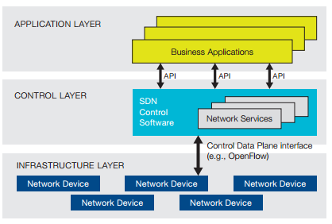
SDN Components at a glance

Slide 27
SDN Components at a glance
Programmable Open APIs:
Connects applications with control plane
Allows for programming of routing, QoS, etc.
Standard Communication Interface (e.g., OpenFlow):
Between control and data planes
Allows direct access to forwarding plane

Slide 28
SDN Components at a glance
Network Controller (logically centralized):
Positioned between both of the above, has full control over the data plane
Sets up rules, actions, etc. for the network devices
Core element of SDN

Slide 29
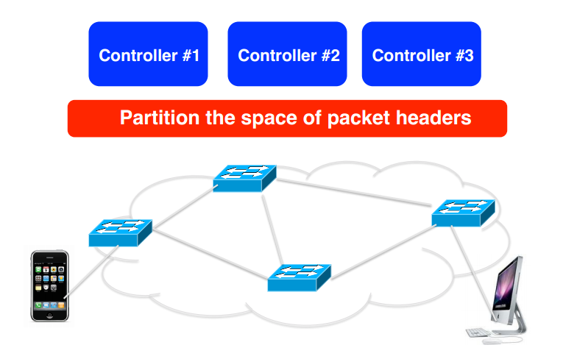
SDN and Network Cloud?
E.g., network virtualization

Slide 30
SDN Benefits
SDN further allows for…
elastic resource allocation (e.g., to match QoS agreements)
distribution of the load on links (e.g., between backbone and application servers)
scalability (no need to manually configure each of thousands (or even millions?) of devices)
overhead reduction
…and more

Slide 31
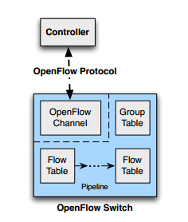
OpenFlow – The SDN Protocol
Communication between the controller and the network devices (i.e., switches)
Specification by the Open Networking Foundation: https://www.opennetworking.org/images/stories/downloads/sdn-resources/onf-specifications/openflow/openflow-spec-v1.3.4.pdf (March 2014)

Slide 32
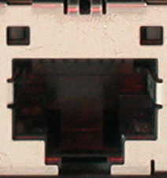
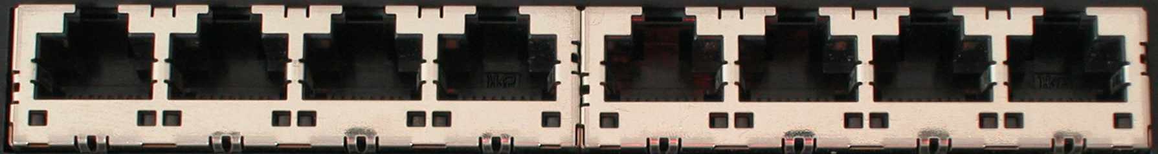
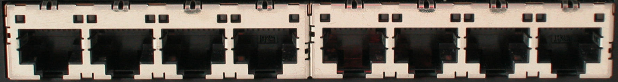
OpenFlow Basics
Control Program A
Control Program B
Network OS
OpenFlow Protocol
Ethernet Switch
Control Path
OpenFlow
Data Path (Hardware)

Slide 33
OpenFlow Basics
Control Program A
Control Program B
Network OS
“If header = p, send to port 4”
Packet
Forwarding
“If header = q, overwrite header with r, add header s, and send to ports 5,6”
“If header = ?, send to me”
Flow
Table(s)
Packet
Forwarding
Packet
Forwarding

Slide 34
Plumbing Primitives <Match, Action>
Match arbitrary bits in headers:
Match on any header, or new header
Allows ‘any’ flow granularity
Action
Forward to port(s), drop, send to controller
Overwrite header with mask, push or pop
Forward at specific bit-rate
Header
Data
Match: 1000x01xx0101001x

Slide 35
General Forwarding Abstraction
Small set of primitives
“Forwarding instruction set”
Protocol independent
Backward compatible
Switches, routers, WiFi APs, basestations, TDM/WDM

Slide 36
OpenFlow – The SDN Protocol
Main components: Flow and Group Tables
Controller can manipulate these tables via the OpenFlow protocol (add, update, delete)
Flow Table: reactively or proactively defines how incoming packets are forwarded
Group Table: additional processing especially for multicast

Slide 37
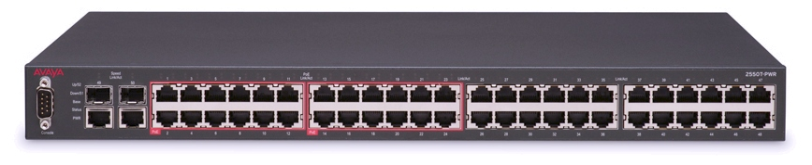
What is OpenFlow? An enabler of software defined Networking
A protocol between SDN controller and OpenFlow switches
Different vendors of both controller and switches can use it
SDN
Controller

Slide 38
What is OpenFlow? (Contd…)
Make it possible for the SDN controller to add matching rules and actions
OpenFlow communicates over TCP. Uses TLS (Transport Layer Security) to make it secure
Normally controller listens on port 6653 for switches (Earlier version used 6633)
Different versions are proposed, these slides cover 1.5 (Last version available to public); (latest version is 1.6, Sept. 2017, not open) - as of 2018
ONF was promoting SDN, and manages the OpenFlow Specification
Notes:
Version 1.6 specification is only available to ONF members

Slide 39
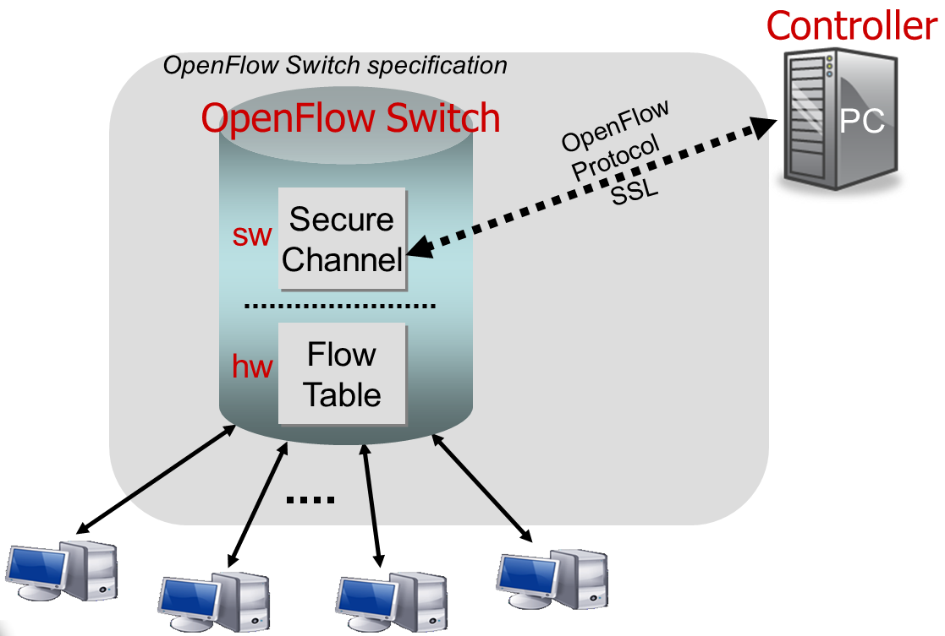
OpenFlow Switch, in Simplest Form
Notes:
This is high level image of an OpenFlow switch
Some part of the implementation may be in software like the protocol to talk with the controller
Normally some parts are implemented in the hardware for the performance, like the flow tables

Slide 40
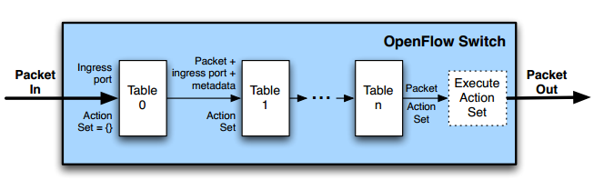
OpenFlow – Switches
Two different versions of an OpenFlow Switch
OF-only (packets can only be processed by OF tables) and OF-hybrid (allows optional normal Ethernet handling )
OF-only: all packets go through a pipeline
Each pipeline contains one or multiple flow tables with each containing one or multiple flow entries

Slide 41
OpenFlow – Switches
Incoming packets are matched against Table 0 first
Find highest priority match and execute instructions (might be a Goto-Table instruction)
Goto: Only possible action - forward

Slide 42
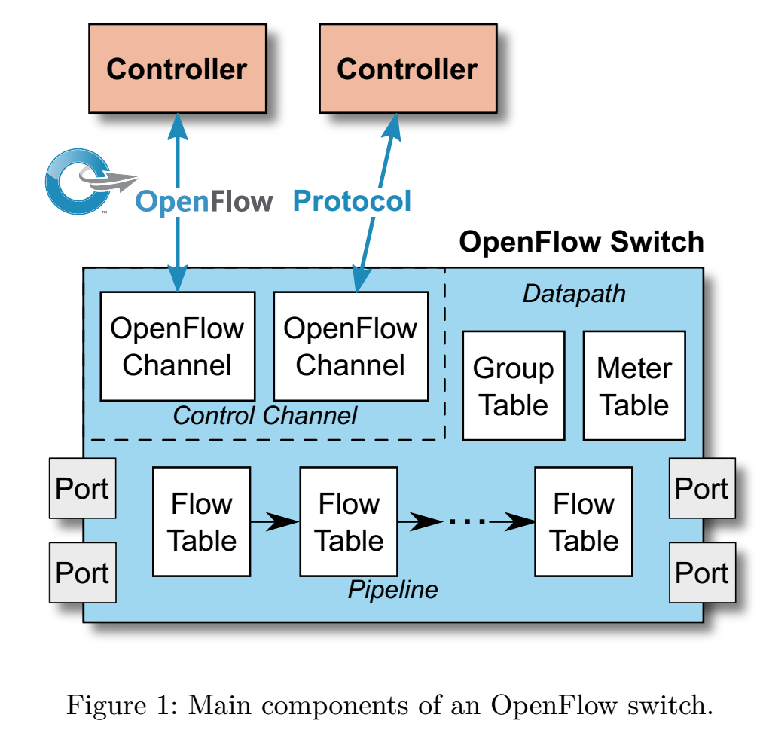
Main Components of V1.5
Controller can add, update, delete flow entries in the flow tables (Reactively or proactively)
So what are flow tables and how are flow tables used ?
(Meter Table is new in V1.5)
Notes:
This is more detailed picture of OpenFlow switch ( For the version 1.5)
Multiple controller can be connected to one switch
So the switch has OpenFlow channels to contact each OF controller
Also the group table and meter table exist (we will explain it later)
These two tables were not existing in earlier versions.
We see a multi level of flow tables (It was not existing in the earlier versions)
Obviously it has ports

Slide 43
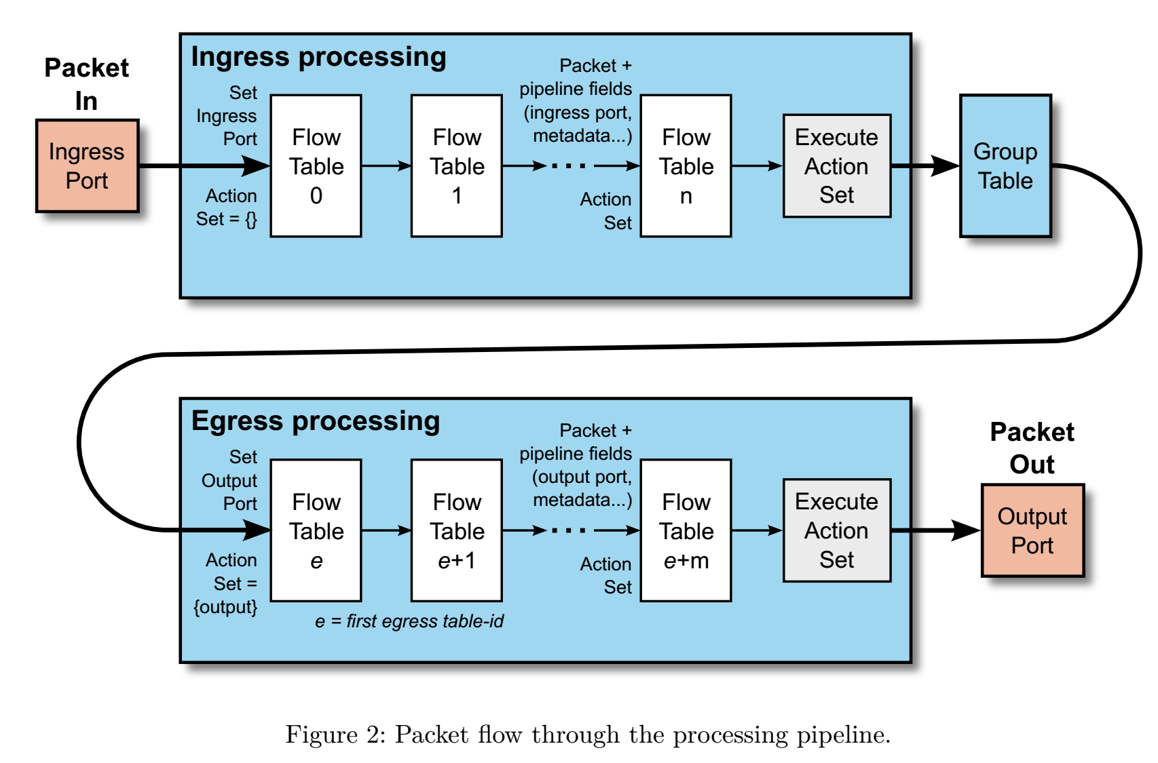
OpenFlow Tables - Pipeline
Notes:
Processing a packet in the OpenFlow switch has three sub steps.
Packet is processed in ingress tables, then group table, and finally in egress tables.
When each packet comes in it goes to the first table of ingress processing with the empty action set.
Each table may make some changes on the packet and also add/remove some actions to the action set.
when packet get to the a flow table without instruction of next table, it execute the actions in the action set.
An action set contain at most on instance of action from each type.
After that it is processed in the group table and finally similar thing happen in the egress processing tables.
However the difference is that the action set of ingress in empty at beginning and action set of egress has OUTPUT action (sending to a port action)

Slide 44
Processing a Packet in an OF Switch
Processing packet in an OpenFlow switch: sub steps:
Packet processed in ingress tables, then group table, and finally in egress tables.
Each packet arrival: goes to first table of ingress processing with the empty action set.
Each table: may make changes to packet & also add/remove actions to action set.
When packet gets to a flow table without instructions of what the next table is: executes the actions in action set.
Action set contains at most one instance of action from each table in the pipeline.
After that it is processed in the group table.
Similar functionality occurs in the egress processing tables.
However the difference is that the action set of ingress is empty at beginning and action set of egress has OUTPUT action (sending to a port action)

Slide 45
OpenFlow – Switches
Flow Table entry structure:
Match fields: where matching applies (i.e., ingress port, packet headers, etc.)
Priority: matching precedence of flow table entry
Counters: update on packet match with entry
Instructions: what to do with the packet
Timeout: max idle time of flow entry before ending (flush entry from table)

Slide 46
OpenFlow – Switches
Flow Table entry structure:
Match fields: where matching applies (i.e., ingress port, packet (IP, eth) headers, etc.)
Priority: matching precedence of flow entry
A flow entry with all match fields as wildcard and priority 0: table miss entry

Slide 47
OpenFlow – Switches
If no match in table: table miss
Handling: depends on table configuration –
might be drop packet, forward to other table, forward to controller
Forward to controller allows to set up a flow entry for that flow (i.e., at the beginning of a flow)

Slide 48
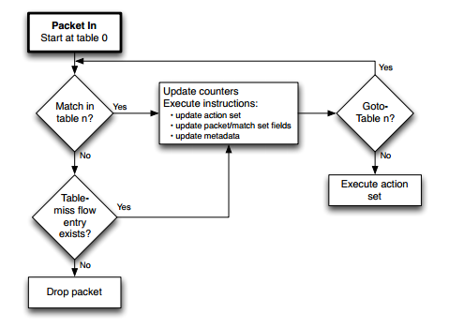
OpenFlow - Matching

Slide 49
OpenFlow – Switches
Group Table entry structure:
Group Identifier: 32-bit ID to uniquely define group on the switch (locally)
Group Type: indirect/all/fast failover/select
Specifies which action bucket is executed
Counters: update on packet processed
Action Buckets: ordered list of buckets, each containing a set of instructions

Slide 50
OpenFlow – Switches
Group Table entry structure:
Group Tables allow for more complex forwarding
E.g., multicast: use all group type to execute all action buckets (packet will be cloned for each bucket, and then forwarded through the instruction set)

Slide 51
Examples
Switching
Switch
Port
MAC
src
MAC
dst
Eth
type
VLAN
ID
IP
Src
IP
Dst
IP
Prot
TCP
sport
TCP
dport
Action
*
*
00:1f:..
*
*
*
*
*
*
*
port6
Flow Switching
Switch
Port
MAC
src
MAC
dst
Eth
type
VLAN
ID
IP
Src
IP
Dst
IP
Prot
TCP
sport
TCP
dport
Action
port3
00:20..
00:1f..
0800
vlan1
1.2.3.4
5.6.7.8
4
17264
80
port6
Firewall
Switch
Port
MAC
src
MAC
dst
Eth
type
VLAN
ID
IP
Src
IP
Dst
IP
Prot
TCP
sport
TCP
dport
Action
*
*
*
*
*
*
*
*
*
22
drop

Slide 52
Examples
Routing
Switch
Port
MAC
src
MAC
dst
Eth
type
VLAN
ID
IP
Src
IP
Dst
IP
Prot
TCP
sport
TCP
dport
Action
*
*
*
*
*
*
5.6.7.8
*
*
*
port6
VLAN Switching
Switch
Port
MAC
src
MAC
dst
Eth
type
VLAN
ID
IP
Src
IP
Dst
IP
Prot
TCP
sport
TCP
dport
Action
port6,
port7,
port9
*
*
00:1f..
*
vlan1
*
*
*
*
*

Slide 53
OpenFlow – OpenFlow Channel
Different message types available:
Controller-to-Switch, Asynchronous or Symmetric
Controller-to-Switch:
Lets the controller control the switch
E.g., Modify-State command to
manipulate flow tables
Asynchronous:
Switch-to-controller requests
(e.g., at table miss)
Symmetric:
May be sent from both ends (e.g., echo command)

Slide 54
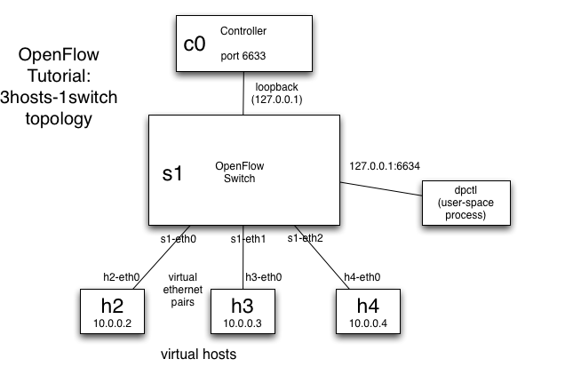
OpenFlow - Example

Slide 55
OpenFlow - Example
SRC: H2
DST: H4

Slide 56
OpenFlow - Example
SRC: H2
DST: H4
?

Slide 57
OpenFlow - Example
SRC: H2
DST: H4
Packet-IN

Slide 58
OpenFlow - Example
SRC: H2
DST: H4
Packet-OUT
Action: eth2

Slide 59
OpenFlow - Example
SRC: H2
DST: H4

Slide 60
OpenFlow - Example
SRC: H2
DST: H4

Slide 61
OpenFlow - Example
SRC: H2
DST: H4
?

Slide 62
OpenFlow - Example
SRC: H2
DST: H4
!

Slide 63
OpenFlow - Example
SRC: H2
DST: H4

Slide 64
If you’re interested…
https://www.opennetworking.org/
“Why SDN is going to change everything” (Bethany Mayer, SVP of Hewlett Packard (HP))
http://h17007.www1.hp.com/de/de/networking/solutions/technology/sdn/#sdn-video
N. McKeown, INFOCOM 2009 keynote on SDN:
http://www.cs.rutgers.edu/~badri/552dir/papers/intro/nick09.pdf

Slide 65
Flow Tables - Entries
Each entry looks like what you have at the bottom:
Match field: Match against the packet. (may consist ingress port, packet header, metadata values set by a previous table)
Priority: set the precedence of the entries.
Counters: Increased when a packet is matched.
Instructions: To modify action set of pipeline (Next slide)
Timeout: Maximum time that, if this rule is not used, then it is deleted from table
Cookie: Not used by packets. Some value selected by controller to filter flow entries
Flags: Alter the way flow entries are managed.
Notes:
Table miss is a flow entry with all wildcards and minimum priority.
Example of the flag: For example, if a rule if idle for a while and it is removed from the flow table, should switch notify the controller or it should not

Slide 66
Flow Tables - Instructions
O – Apply-Actions (actions)
Apply the specific action immediately without making any change to the action set
Packet can be modified between two tables
R – Clear-Actions: Clear all the actions in the action set
R – Write Actions (actions): Merge specified action to the action set
O – Write Metadata (metadata/mask): Write masked value to the meta data field
O – Stat-Trigger (threshold): Generate an event to controller if some stats passed some thresholds
R – Goto-Table (table-ID): Indicate next table id in the pipeline
R- Required, O-Optional
Notes:
Instructions are executed when a packet matches an entry
So what are actions that we have mentioned here? (explanation in the next slide)

Slide 67
Actions: Apply-Actions instruction
1. Copy TTL Inward
2. pop
3. push MPLS
4.push PBB (provider backbone bridge)
5. push VLAN
6. Copy TTL outwards
7. decrement TTL
8. Set (field)
Apply all set field actions to the packet
9. Qos (queue and meter)
Apply all QoS actions to the packet
10. Group
11. Output
Forward packet to specified port (if no group action is specified)
Notes:
Also they are executed in the order too.
Provider Backbone Bridges (PBB; known as "mac-in-mac") is a set of architecture and protocols for routing over a provider's network allowing interconnection of multiple Provider Bridge Networks without losing each customer‘s individually defined VLANs.

Slide 68
Actions of the action set of the packet
R - Output (port no)
Forward packet to port that then starts packet egress processing
O – Group (group id)
Process the packet through a group id
R – Drop
O – set Queue (queue id)
Set queue id for the packet
O – Meter (Meter id)
Direct packet to specific meter
O – push/pop tag
Like VLAN tags
O -Set-Field field-type value
Set value of the field in the header
O -Copy-Field src-field dst-field
Copy data between header fields
O - Change TTL

Slide 69
OpenFlow Ports
Physical
Hardware interface of the switch (or a virtual slice of the interface)
Logical
Higher level of abstraction, it can be aggregation groups, tunnels, loopback interfaces
Packet has an extra field in logical ports called tunnel-ID
Reserved
They define generic forwarding actions such as sending to controller, flooding, forwarding with non-OpenFlow methods
It means we have a port called ALL (to send to all ports), CONTROLLER (to send to controller), TABLE (start of pipeline), IN_PORT (the ingress port that we got the packet, NORMAL (non OpenFlow pipeline) and a couple of other additional ports.

Slide 70
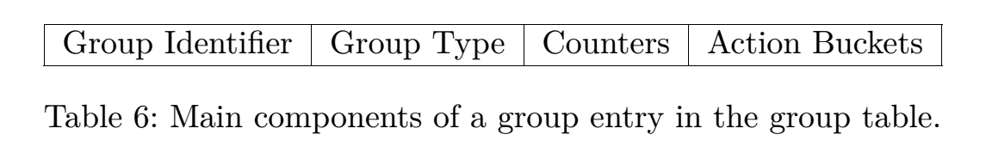
Group Table
Group ID: An integer specifying a group
Group type: To determine group semantic (Next Slide)
Counter: Updated when packet processed by the rule
Action Buckets: Contains a set of actions
Ordered

Slide 71
Group Types
R – Indirect
Has a single bucket and it is executed for all packets
R – All
It is a number of buckets and all of them are executed
Normally used for multicast or broadcast forwarding
Packet is cloned for each bucket
O – Select
One of the buckets in the provided buckets is selected for each packet
It can be used for load sharing and the selection algorithm is outside the scope of OpenFlow switch
O – Fast Failover
It execute the first available bucket
For example, each bucket can be related to different ports and if a port is down, that bucket is not selected and one of the other buckets is selected
It can be used to handle failover without contacting the SDN controller

Slide 72
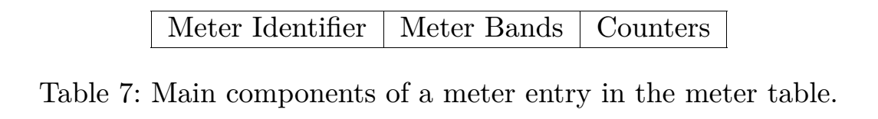
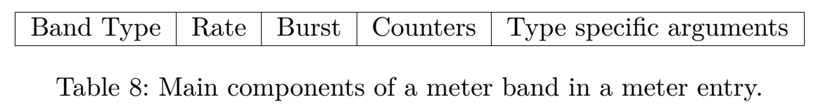


Meter Table
It contains Meter entries. Enables OF to have rate limiting and simple QoS
It also can be used for more complex QoS policies such as DSCP
Band types:
Rate: Target rate for the band
Notes:
Meters are fully independent from of per-port queues
However they can be combined to have something like DiffServ.
Meter ID: Identify a meter
Metter band: Is depicted in the second picture
Each band specifies the rate of the band and the way to process the packet.
Counters: Similar to Other counters
Meter band explanations:
Band Type: Define how packets are processed
Optional drop: drops the packet
Optional DSCP remark
Increase the drop precedence of the DSCP field in the IP header.
Can be used for DiffServ
Rate: target rate for the band
Burst: define granularity of the band
Counter: similar to other counters
Type specific arguments: some types have specific parameters
Packets are processed only by a single meter band
Packets must be processed by a meter band only if the meter measured rate exceeds the band target rate

Slide 73
OpenFlow Messages
Controller to Switch
Started by controller
Used to manage or inspect state of the switch
Asynchronous (It is from Switch to controller)
Update controller about network events
Symmetric
It can be initiated by either

Slide 74
OpenFlow Messages – Controller to Switch
Features: : controller wants to know the capabilities of the switch
Configuration: query about the configurations of the switch
Modify-State: add, delete and modify flow/group entries and insert/remove action buckets of groups and also set switch port properties
Read-State: current configuration and stats and capabilities of the switch.
Packet-out: to send packet out of a specific port on the switch (for the packets that were received by packet-in message)
Barrier: To ensure message dependencies (to ensure things are done atomically)
Role-Request: When a switch is connected to multiple controllers, they have different roles. By this approach, the SDN controller can notify the switch about their roles.
Asynchronous-Configuration: to set filters about the asynchronous messages that the controller like to receive from switch.
Notes:
- Feature: controller wants to know the capabilities of the switch.
- Configuration: query about the configurations of the switch
- Modify-state: add, delete and modify flow/group entries and insert/remove action buckets of groups and also set switch port properties
read-state: current configuration and stats and capabilities of the switch. (The explanation is based on the specification but I think it is mostly to read the state in the tables and not the capabilities and so on which is state by specification)
Packet-out: to send packet out of a specific port on the switch (for the packets that they were received by packet-in message.
Barrier: To ensure message dependencies (to make sure things are done atomic)
Role Request: When switch is connected to multiple controller, they have different roles. By this approach, the SDN controller can notify the switch about their roles.
Asynchronous configuration: to set filters about the asynchronous messages that the controller like to receive from switch.

Slide 75
OpenFlow Messages – Asynchronous
Packet-In: Transfer control of the packet to controller. Switch notifies controller that it has received a packet and has a table miss for it. Although, other operations like changing TTL may also end up with sending packet-in message.
Flow-Removed: inform controller that a flow is removed from the flow table.
Port-Status: Update the controller about an update in the state of the port.
Role-status: Inform the controller about an update in its role. For example, if a new master SDN controller introduces itself to the switch, the switch informs other SDN controllers that they are not master any more.
Controller-Status: when there is a problem in the channel between the switch and SDN controller, the switch notifies the controller about it. (?)
Flow Monitor: Inform the controller about a change in the flow table.
Notes:
- Packet-in: Transfer the control of the packet to the controller. Switch notify the controller that it has received a packet and has a table miss for it. Although, other operation like changing the TTL may end up with sending packet in message.
- Flow removed: inform the controller that a flow is removed from the flow table.
- Port status: Update the controller about an update in the state of the port.
- Role-Status: Inform the controller about an update in its role. For example, if a new master SDN controller introduce itself to the switch, the switch inform other SDN controllers that they are not master any more.
- Controller status: (Not very clear to myself) Probably when there is some problem in the channel between the switch and SDN controller, the switch notifies the controller about it.
- Flow monitor: Inform the controller about a change in the flow table.

Slide 76
OpenFlow Messages – Symmetric
Hello
Exchanged message upon making a new connection between switch and controller
Echo
It is to verify the other side is still alive and it can used to measure delay and bandwidth
Error
Notify problems to the other side. Normally a failure for the request of the other side.
Experimenter
For experiments and additional functionalities.

Slide 77
Connections
Switches have a main connection to the master controller
Possibly auxiliary connections exist for connecting to other controllers
For reliability purposes
The OpenFlow protocol is over tls, dtls, tcp, udp (default port 6653)
Notes:
Normally a controller have multiple channel to exchange data with different switches.
A switch may have multiple channels to multiple controllers for the sake of reliability.
Auxiliary connections

Slide 78
Multiple Controllers
When there is more than one controller, the controllers can be in contact with each other (out of scope of OpenFlow) but they can use these mechanism to handle different OpenFlow switches.
Equal
In this mode, the controller has full access and control to switch and it has equal rights with other controllers, it receives all asynchronous messages and it can change the state of the switch.
Slave
The controller has read only access. It does not receive asynchronous messages but port status messages.
Master
Similar to equal role with full access to the switch, just that the switch makes sure that there is only one controller in the master role.
Notes:
When there is more than one controller, the controllers can be in contact with each other which is out of scope of OpenFlow but they can use mentioned mechanism to handle different OpenFlow switches.

Slide 79
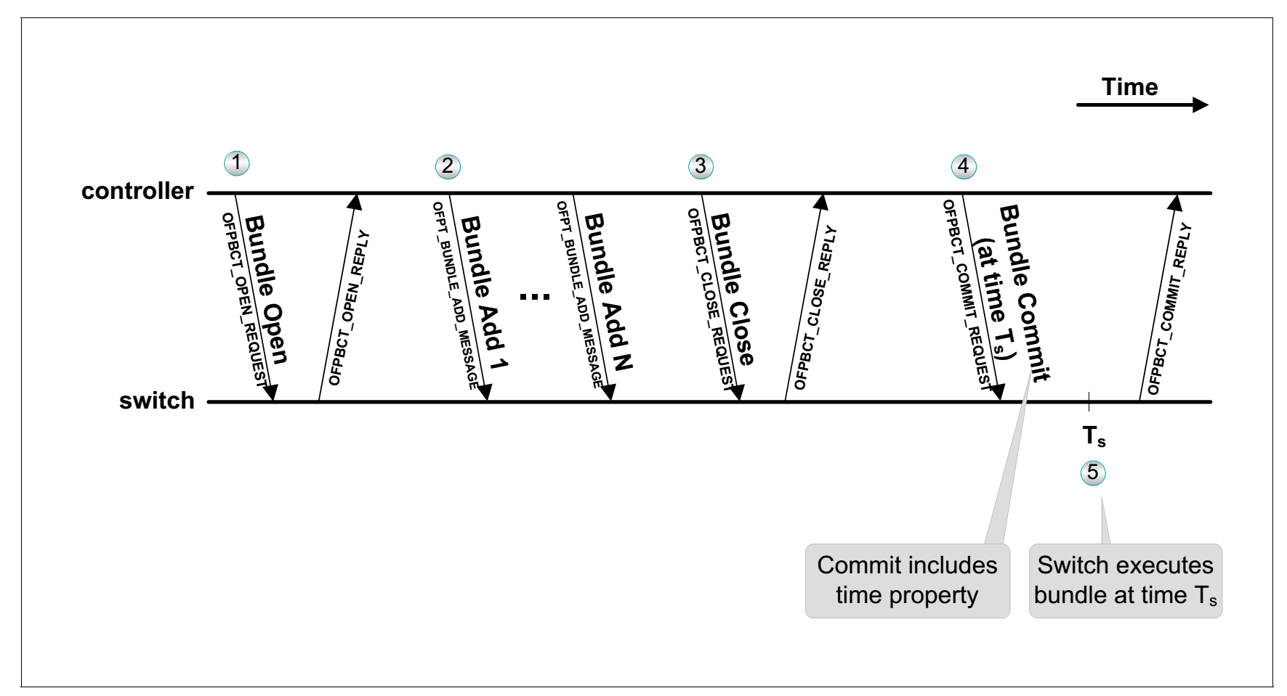
(Scheduled) Bundle Messages
Sequence:
A bundle is opened; A number of commands are sent
A bundle is closed; A time is set
Switch executes the commands and notify the controller that it has executed the commands.
A bundle commit request may include an execution time, specifying when the bundle should commit.
Switch tries to commit the bundle as close as possible to the time.
Notes:
This part is new concept. Not related directly to previous slides.
A bundle commit request may include an execution time, specifying when the bundle should commit.
Switch tries to commit the bundle as close as possible to the time.
Explanation of the graph:
A bundle is opened
A bunch of commands are sent
A bundle is closed
A time is set
Switch execute the commands.
It notify the controller that it has executed the commands.

Slide 80
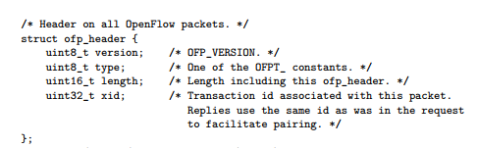
OpenFlow Header
Notes:
Version
Type of message
Length of message including the header length
Transaction ID

Slide 81
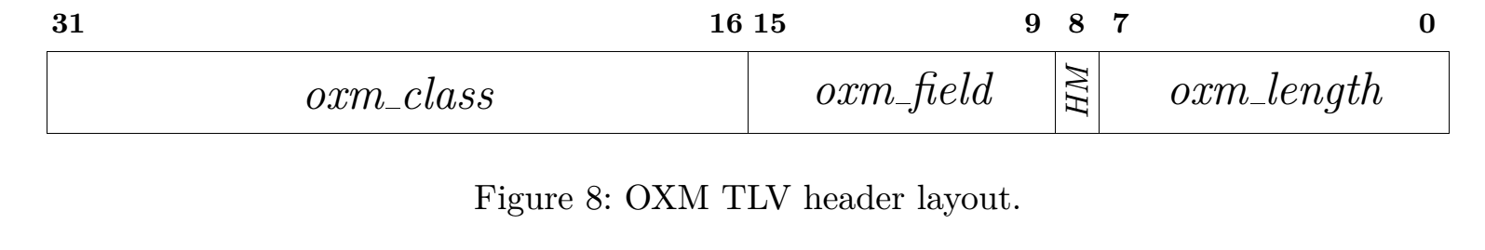
Flow match structure
Flow match structure uses OpenFlow Extensible Match (OXM)
It is a compact TLV( Type-Length-Value)
5 to 259 Bytes (4 Bytes header)
Oxm_class: matches the class of the object; Oxm_field: matches the field within the class
Oxm_hasMask: set if the oxm includes a bitmask
If 0: the value should match
If 1: the payload is value:bitmask
For example 1110:1110 matches 111x, 110100:111100 matches 1101xx
Oxm_length: length of oxm payload
For example: Class can be OFPXMC_OPENFLOW_BASIC - Field can be:
OFPXMT_OFB_IN_PORT = 0, /* Switch input port. */
OFPXMT_OFB_IN_PHY_PORT = 1, /* Switch physical input port. */
OFPXMT_OFB_METADATA = 2, /* Metadata passed between tables. */
OFPXMT_OFB_ETH_DST = 3, /* Ethernet destination address. */
Notes:
Oxm_class: matches the class of the object
Oxm_field: matches the field within the class
Oxm_hasMask: set if the oxm includes a bitmask
If 0: the value should match
If 1: the payload is value:bitmask
For example 1110:1110 matches 111x, 110100:111100 matches 1101xx
Oxm_length: length of oxm payload
For example:
Class can be OFPXMC_OPENFLOW_BASIC
Field can be:
OFPXMT_OFB_IN_PORT = 0, /* Switch input port. */
OFPXMT_OFB_IN_PHY_PORT = 1, /* Switch physical input port. */
OFPXMT_OFB_METADATA = 2, /* Metadata passed between tables. */
OFPXMT_OFB_ETH_DST = 3, /* Ethernet destination address. */
…..

Slide 82
OpenFlow v 1.0 new features
Slicing: multiple queues per output port
Flow cookies: Identifier for each flow entry

Slide 83
OpenFlow History - V1.1 Added features
Multiple Tables
Have a pipeline of the tables
Groups
Make it possible to have multicasting
Tags (MPLS, VLAN)
Virtual Ports

Slide 84
OpenFlow History - V1.2
IPV6 support
Extensible match support (OXM which increases flexibility dramatically)
Controller role change mechanism
Extensible set field packet rewriting support (by leveraging OXM)

Slide 85
OpenFlow History - V1.3
Per Flow Meters (To measure and control rate of packets)
Connecting to multiple controllers and auxiliary connections
Cookie in packet in (help controller to more efficiently classify packets)
Tunnel-ID metadata (For example make it possible to do GRE encapsulation)

Slide 86
OpenFlow History - V1.4
Flow Monitoring (monitor in real time the changes made by other controllers in a subset of flow table)
Eviction
Replace older rules with newer rules when the flow table capacity is reached
Vacancy
Controller can get early warning about capacity of the table
Bundles
Apply a group of OpenFlow messages at the same time
Synchronized tables

Slide 87
OpenFlow History - V1.5
Egress Tables
Processing can be done in context of input port and output port by having egress tables
Packet aware pipeline
All the packets no longer need to be ethernet packets
Flow Entry statistics trigger
Define flexible trigger for the stats
Copy-Field action
Copy between two OXM fields
TCP Flags Matching
Detect SYN, FIN, ACK to detect TCP connection’s states
Scheduled Bundles
Execute bundle at a specific time
Meter Action
Meter action instead of meter instruction (Multiple meter can be attached to a flow entry and it can be used in group buckets)

Slide 88
Conclusion
A necessary interface between SDN controller and switches
It should not be tied to vendors and it should be flexible
Also it should be simple enough to make it possible to implement it on different types of switches

